Slide 1


Academic Earth
A web-based tutorials/courses finder and sharing application.
Aman Kushwaha ( 181500075 )
Satish Narayan Gupta (181500626)
Ayush Gupta (181500172 )

Slide 2

Introduction
Academic Earth believes that everyone has the right to a world-class education. We are building a cloud based Web Application for online learners. 'E-Learning explores interactive technologies and communication systems to improve the learning experience.
Users of our application could be anyone who wants to find a course, articles etc. from different online course providers. They will be able to like and share the course, they can add sources to our web application

Slide 3




Motivation
Many people face the problem when they want to learn something new or they have some skills which they want to share among people, then they can add their content/sources on our web application.
In our application many users provide various sources in one place so that learners need not to worry about where to gain new skills. They can choose one of the best sources among these and start learning.
It makes possible a truly ambitious education system for a future learning society.

Slide 4

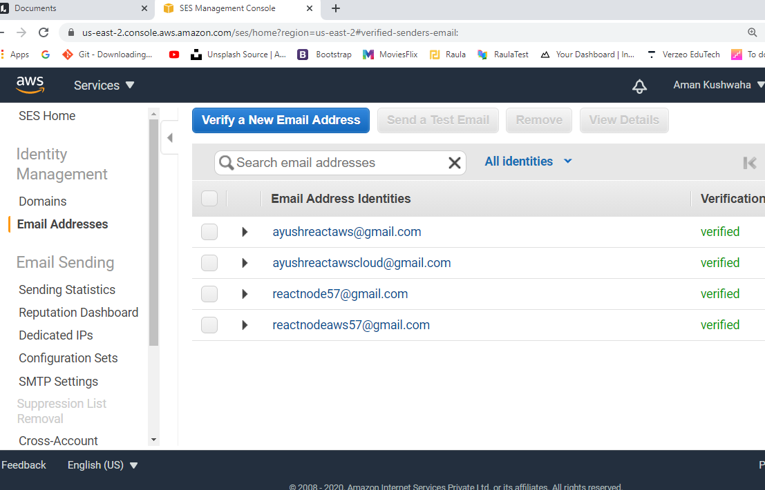
AWS services used
Amazon Simple Email Service:
Amazon Simple Email Service (SES) is a cost-effective, flexible, and scalable email service that enables developers to send mail from within any application. You can configure Amazon SES quickly to support several email use cases, including transactional, marketing, or mass email communications. With Amazon SES, you can send email securely, globally, and at scale
amanreact57@gmail.com

Slide 5
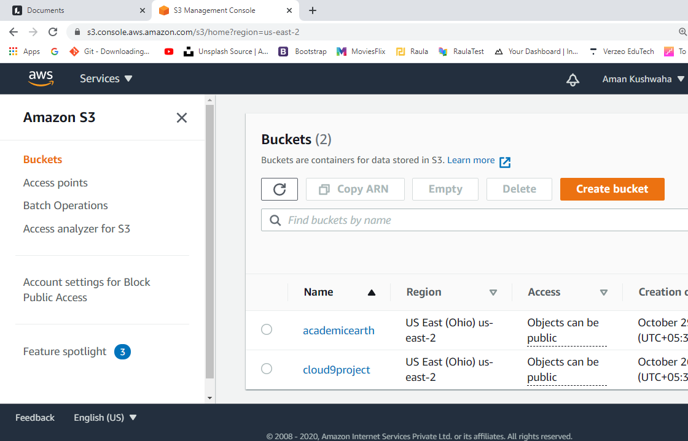
AWS services used
Amazon S3:
Amazon Simple Storage Service (Amazon S3) is an object storage service that offers industry-leading scalability, data availability, security, and performance. Amazon S3 provides easy-to-use management features so you can organize your data and configure finely-tuned access controls to meet your specific business,. Amazon S3 is designed for 99.999999999% (11 9's) of durability, and stores data for millions of applications for companies all around the world.

Slide 6

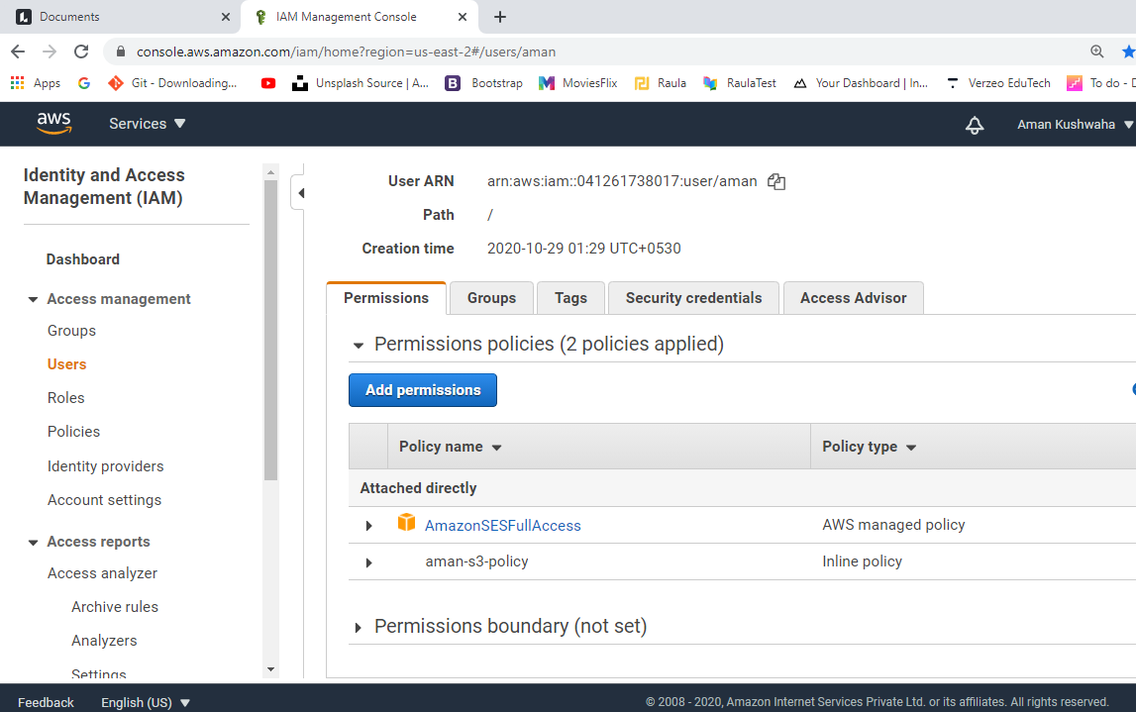
AWS services used
AWS Identity and Access Management (IAM) :
AWS Identity and Access Management (IAM) enables you to manage access to AWS services and resources securely. Using IAM, you can create and manage AWS users and groups, and use permissions to allow and deny their access to AWS resources.

Slide 7

AWS services used
Amazon EC2:
Amazon Elastic Compute Cloud (Amazon EC2) is a web service that provides secure, resizable compute capacity in the cloud. It is designed to make web-scale cloud computing easier for developers. Amazon EC2’s simple web service interface allows you to obtain and configure capacity with minimal friction. It provides you with complete control of your computing resources and lets you run on Amazon’s proven computing environment.

Slide 8

Project Status:
Back-End Portion completed: 45%
Registration Page (SES) , Login Page
Forgot Password
Admin Access profile
Categories of Courses (S3)
Resources upload
Back-End On-Progress:
Click Count
Trending Links
Category / Profile update
Deployment

Slide 9

Hardware and Software requirements
Hardware Requirements:
Personal Computer with minimum of 4GB RAM and core i3 Processor.
Software Requirements:
Windows Operating System.
Visual Studio Code
GitHub Desktop

Slide 10
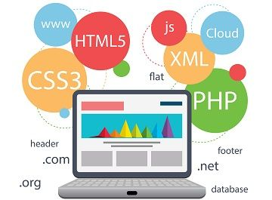
Technologies used
Language and Framework Requirements:
REACT JS
CSS3
BOOTSTRAP 4 / 5
Node JS
Express JS
Next JS
MongoDB
Cloud Platform:
Amazon Web Services ( AWS )
SES ,IAM, EC2 and S3

Slide 11
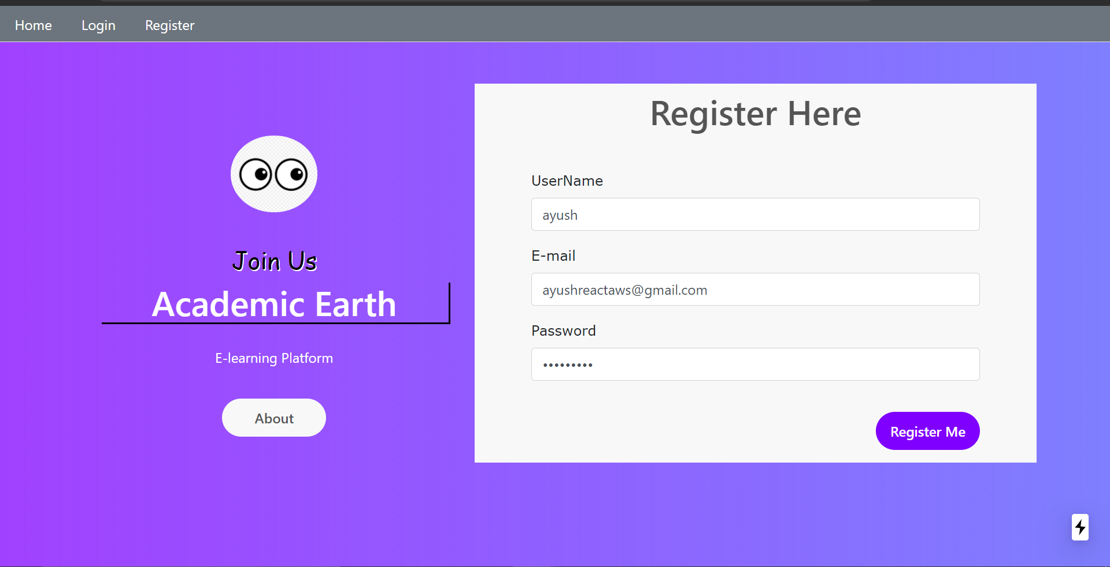
Design : Registration page

Slide 12
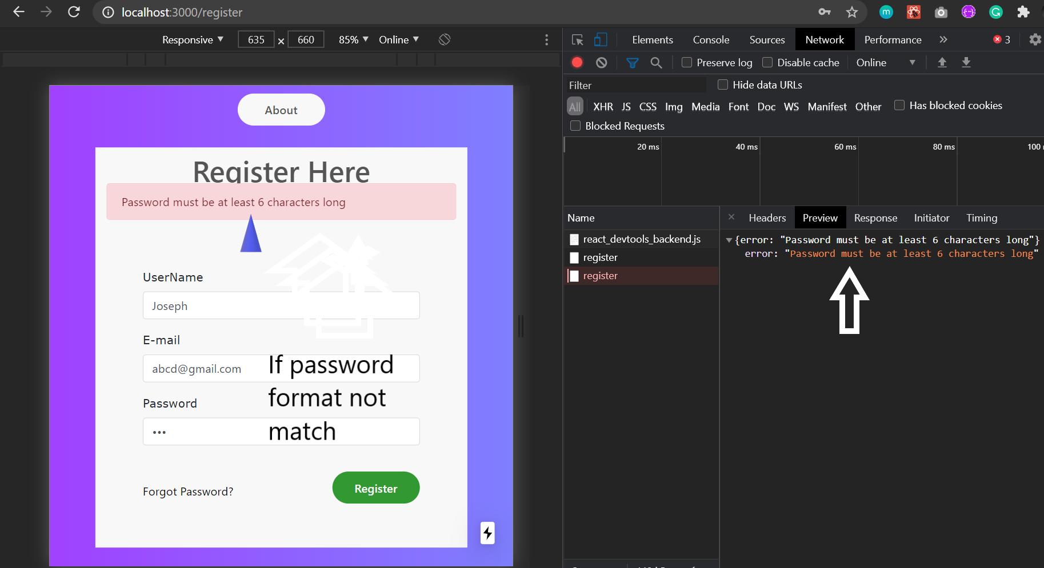
Registration - Apply Validations on each input field

Slide 13
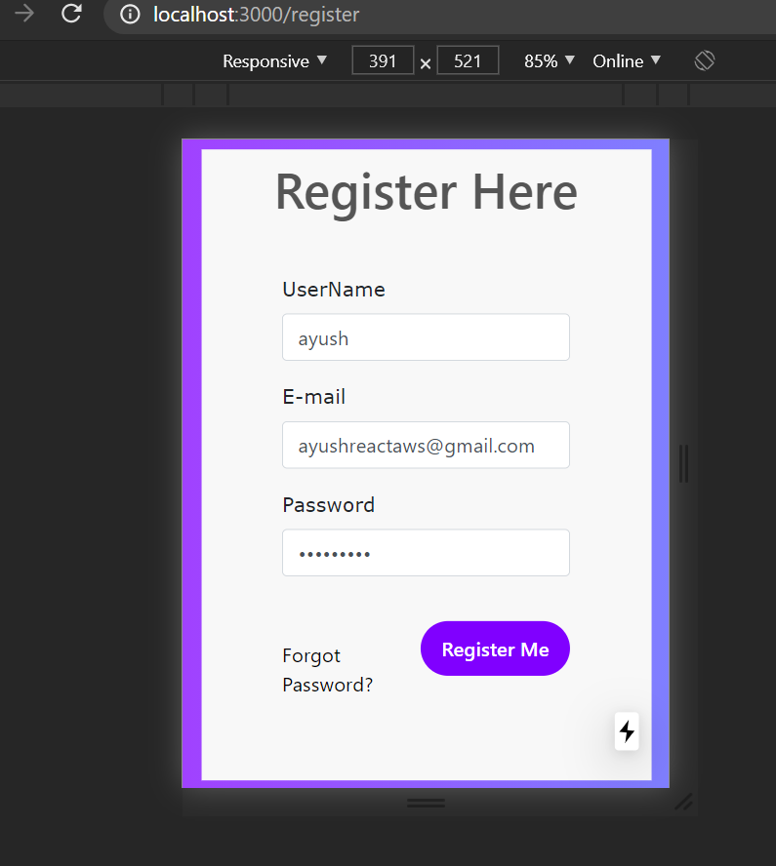
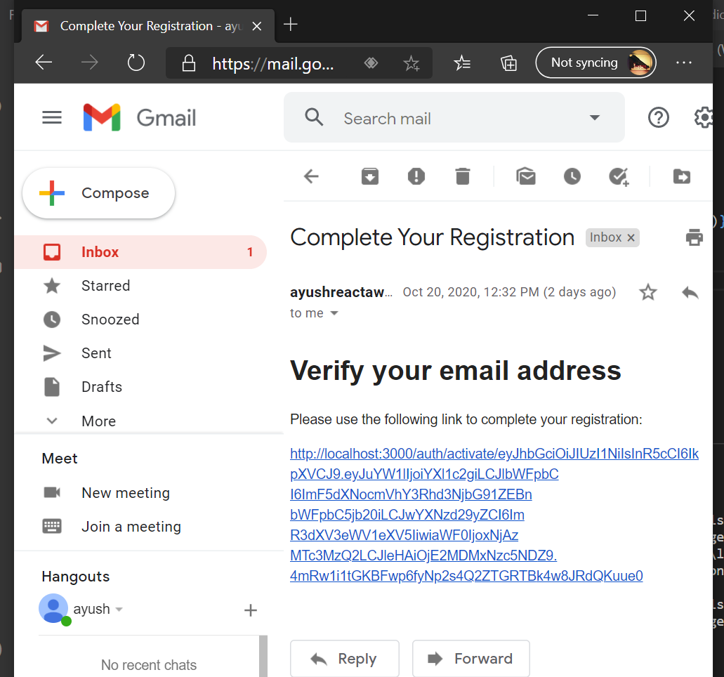
Register user and send email using AWS SES

Slide 14
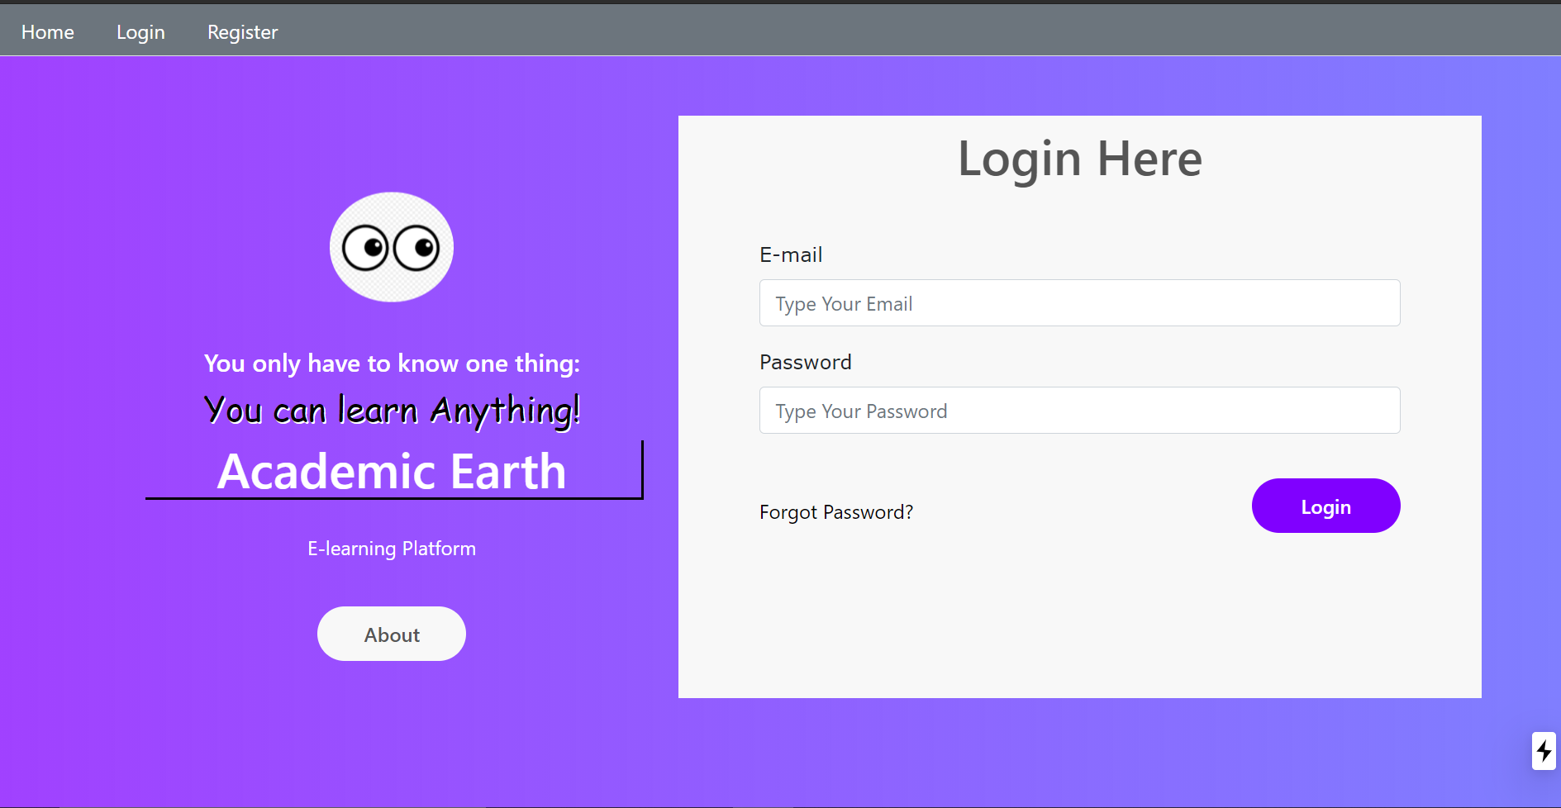
Sign in page

Slide 15
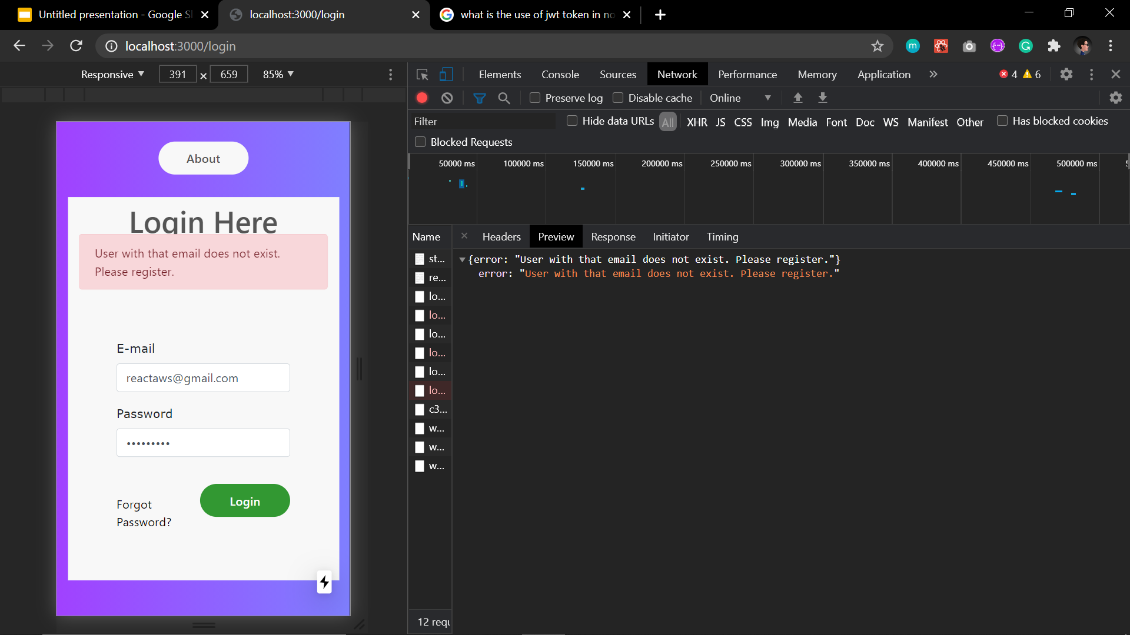
Sign in validation

Slide 16
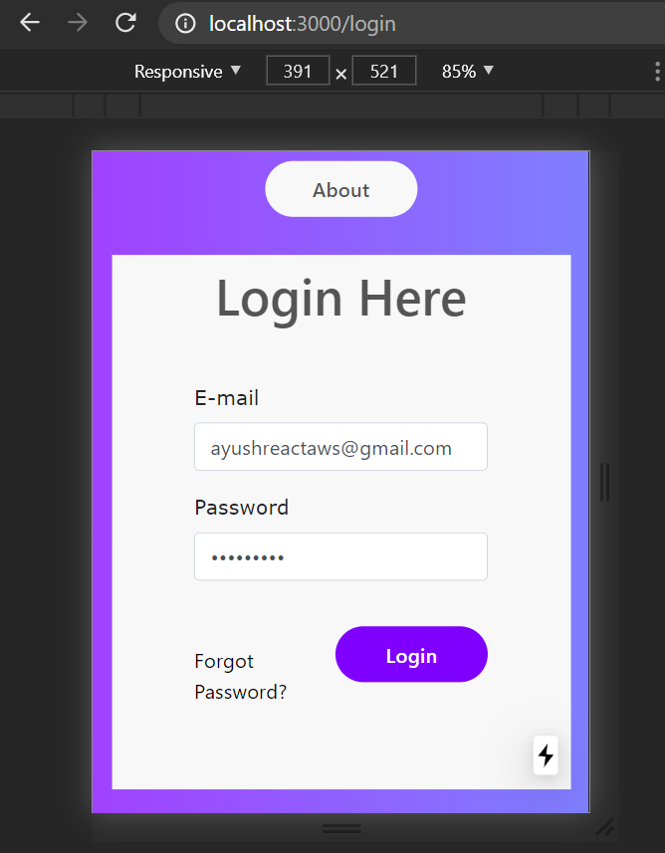
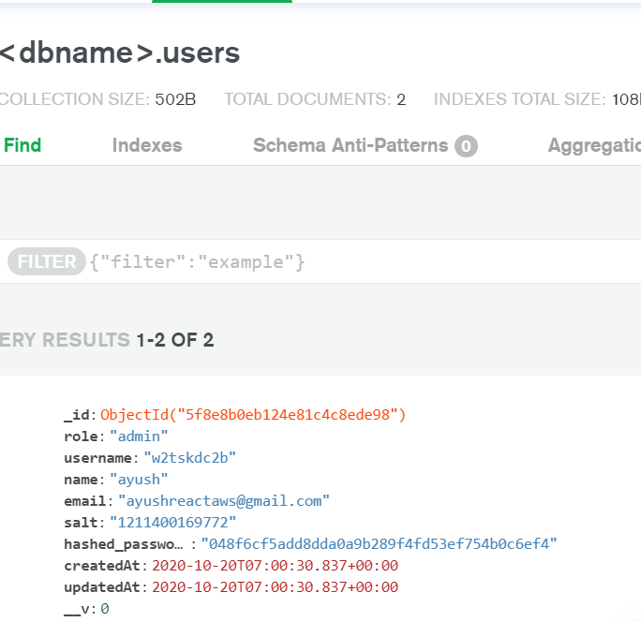
User details saved in MongoDB Atlas

Slide 17
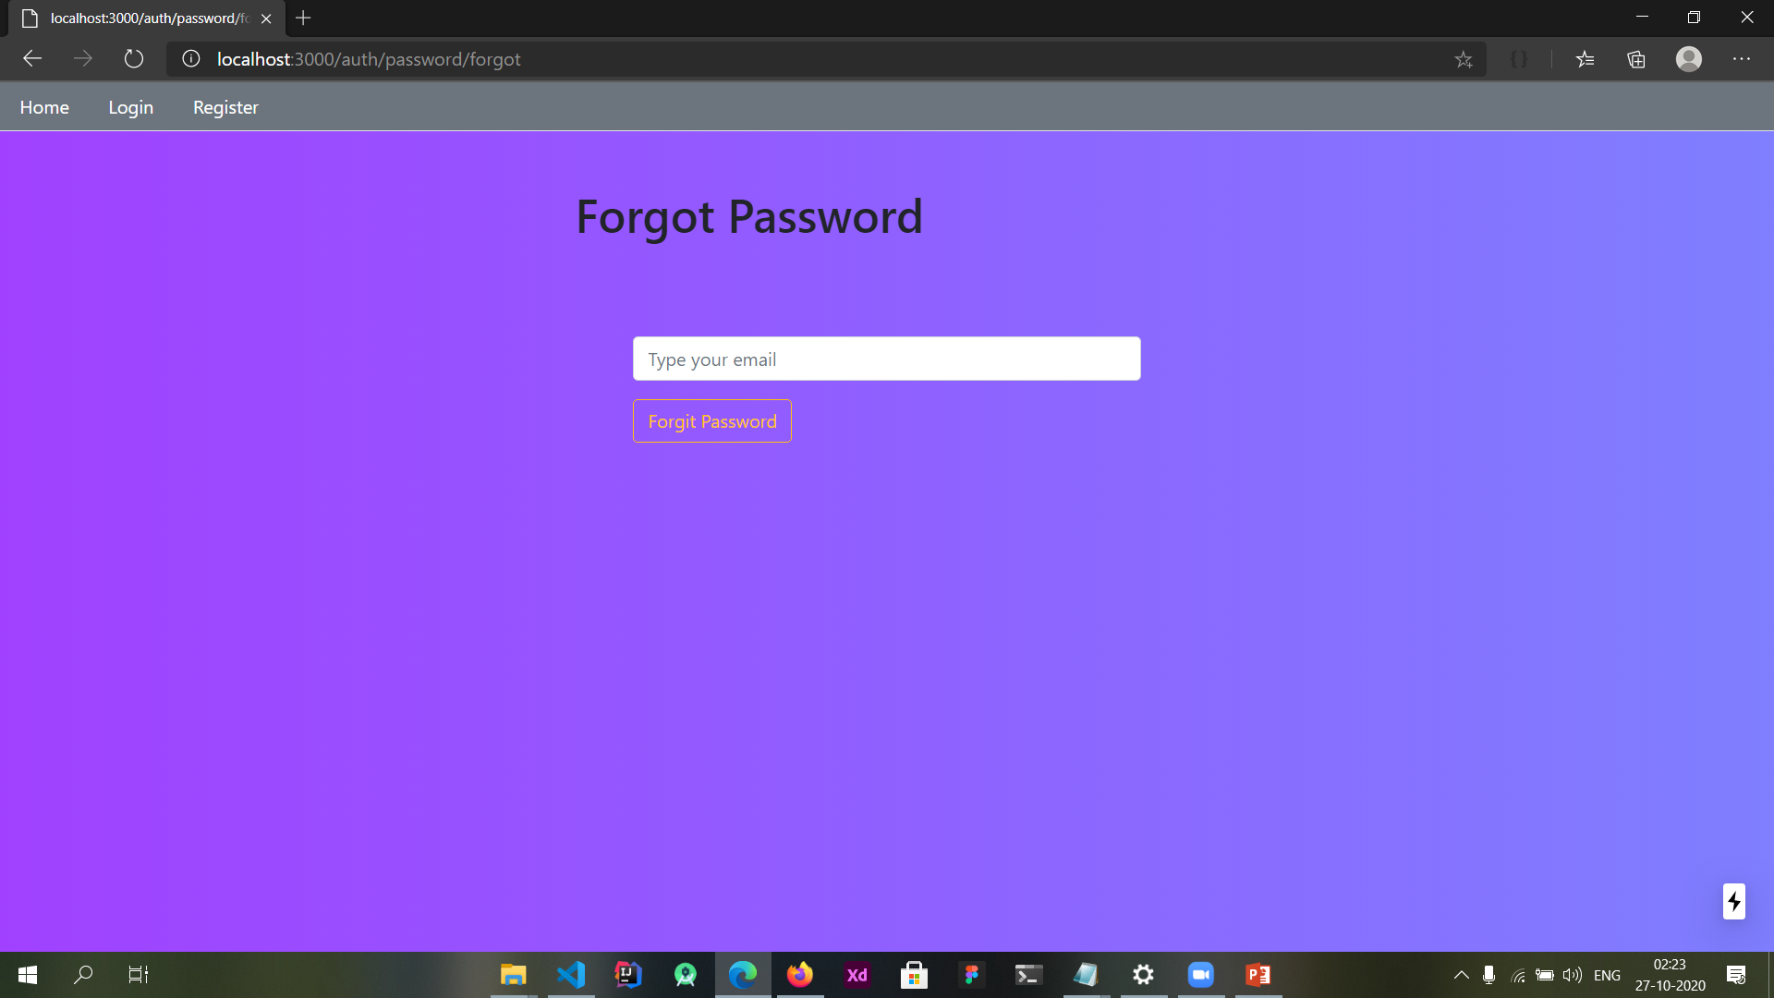
Forgot Password Page

Slide 18
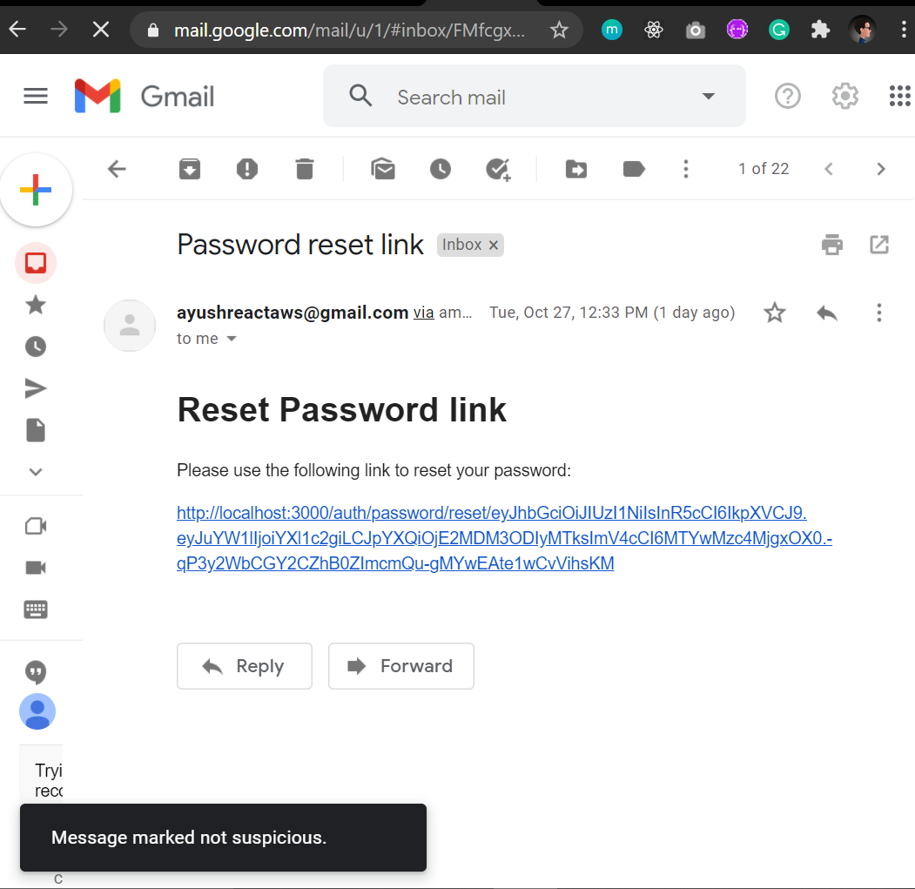
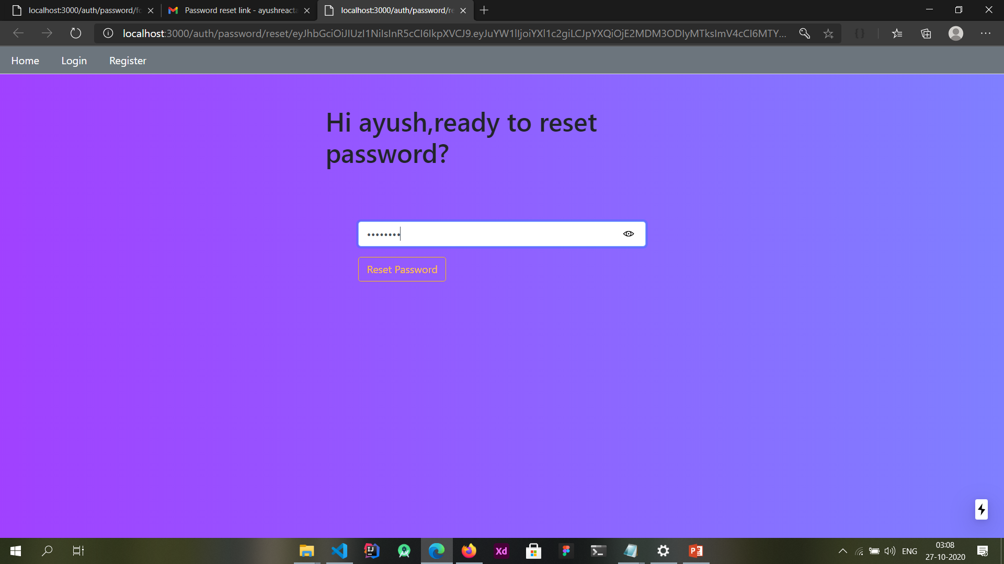
Email is send to reset password

Slide 19
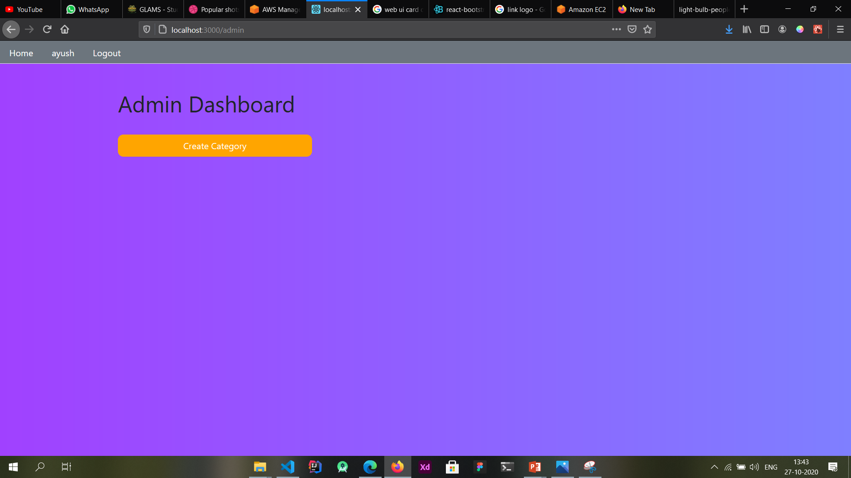
Click to create new category

Slide 20
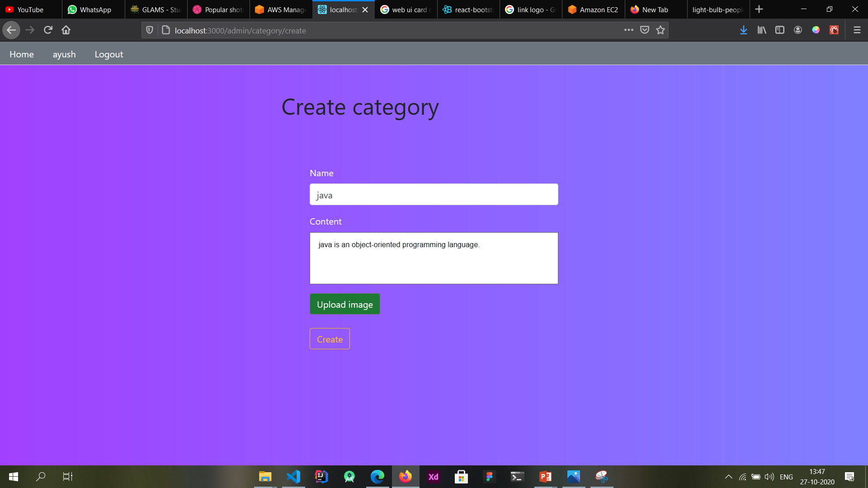
Fill form to create category

Slide 21
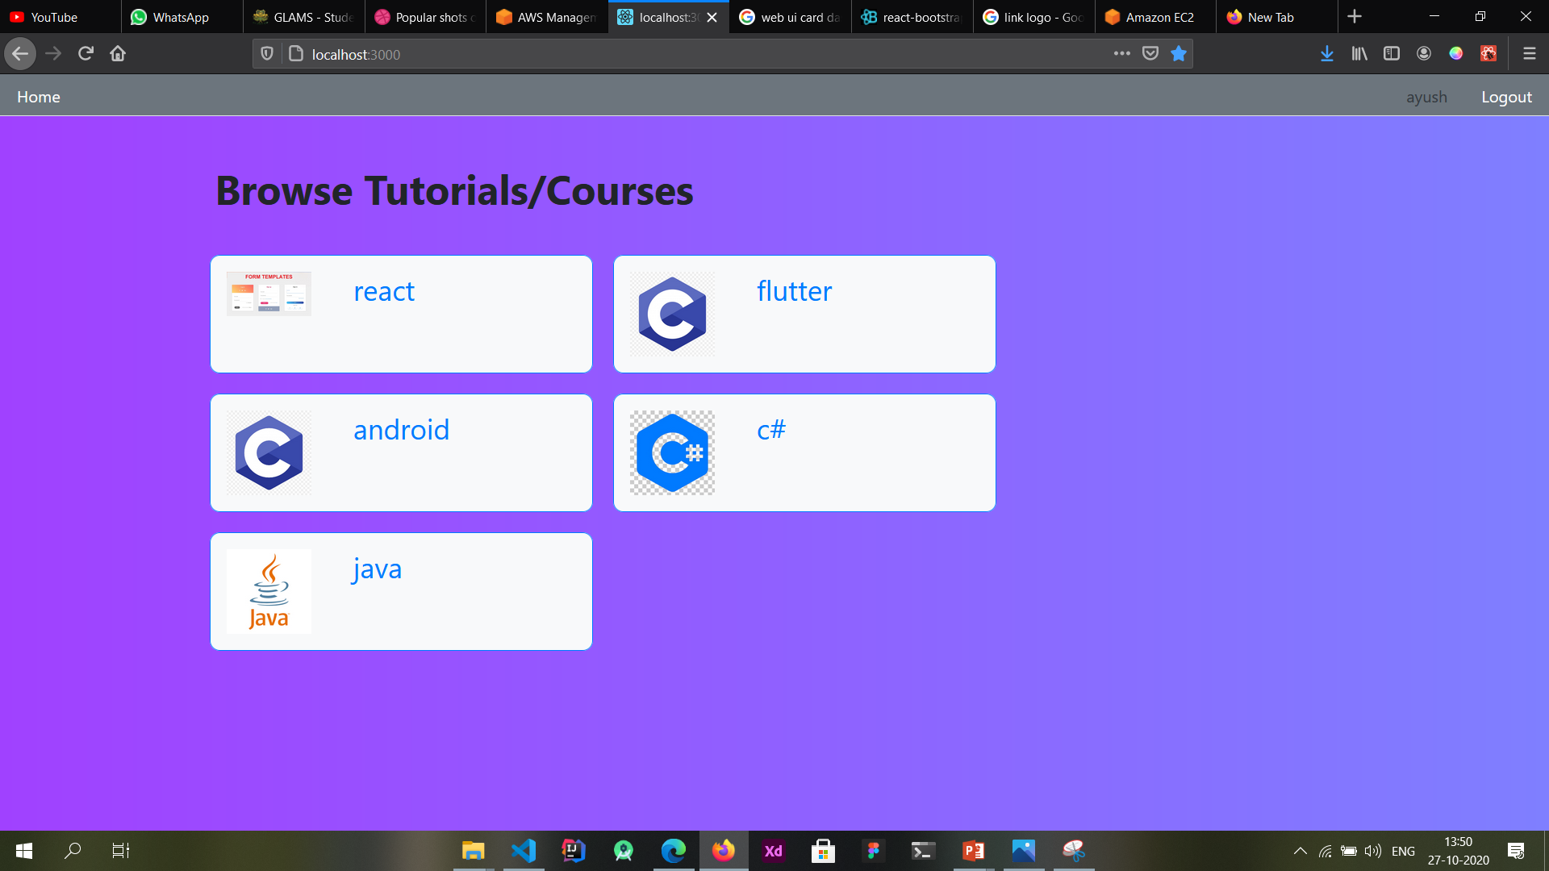
New Category Created

Slide 22
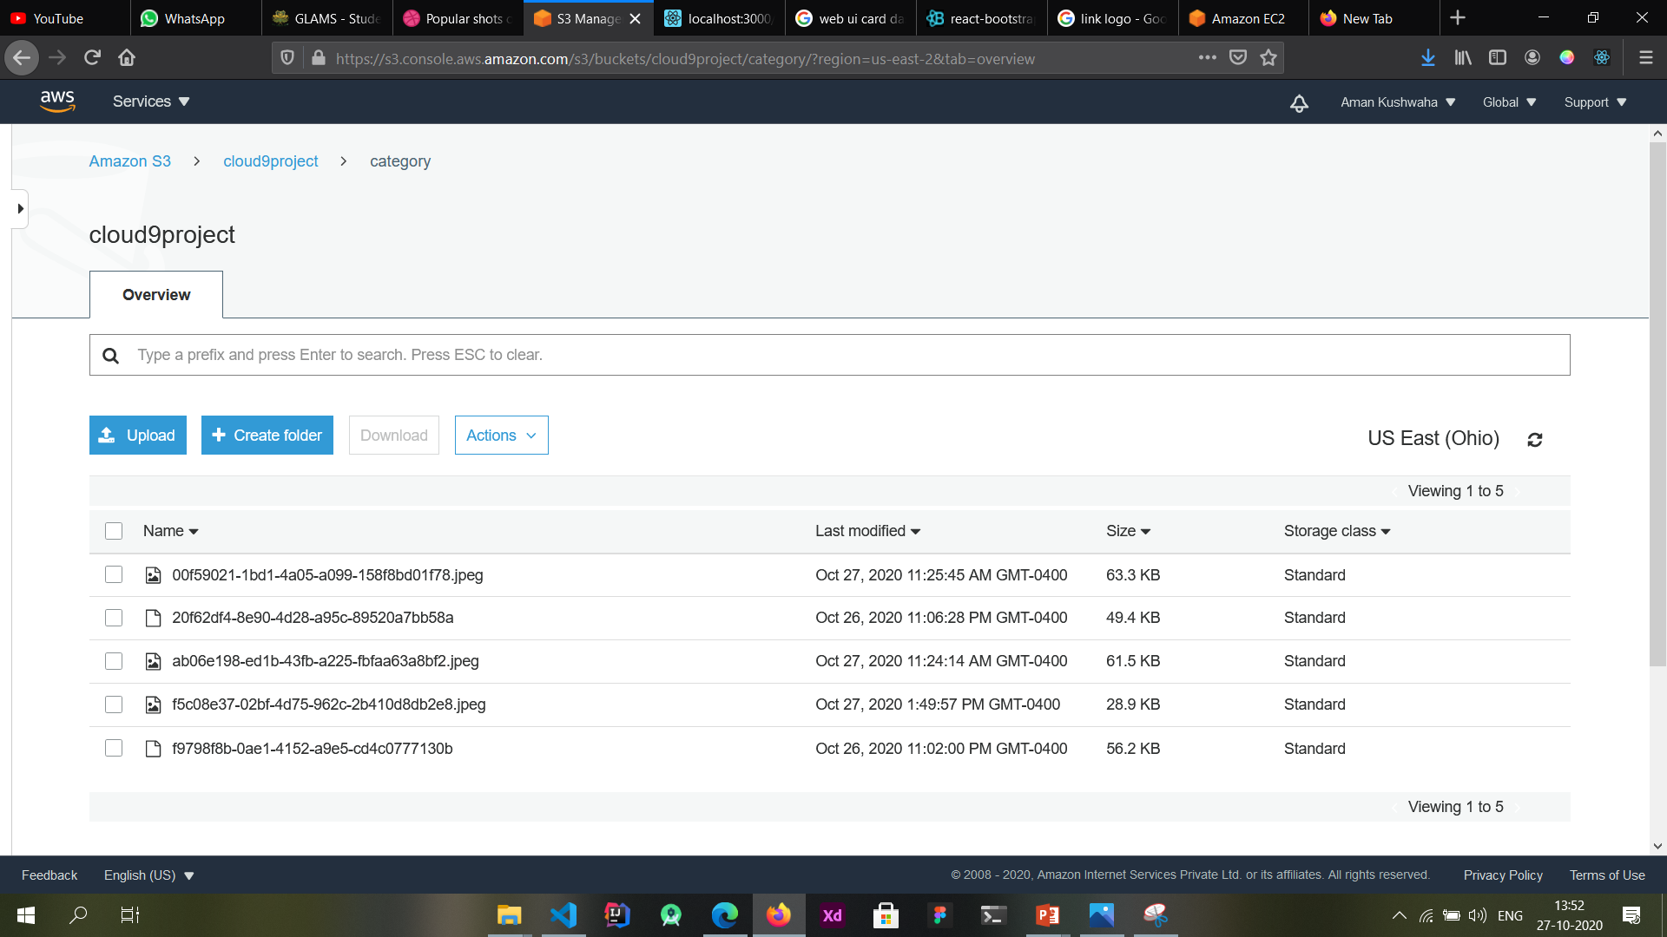
Category Image is Stored on S3 Bucket

Slide 23
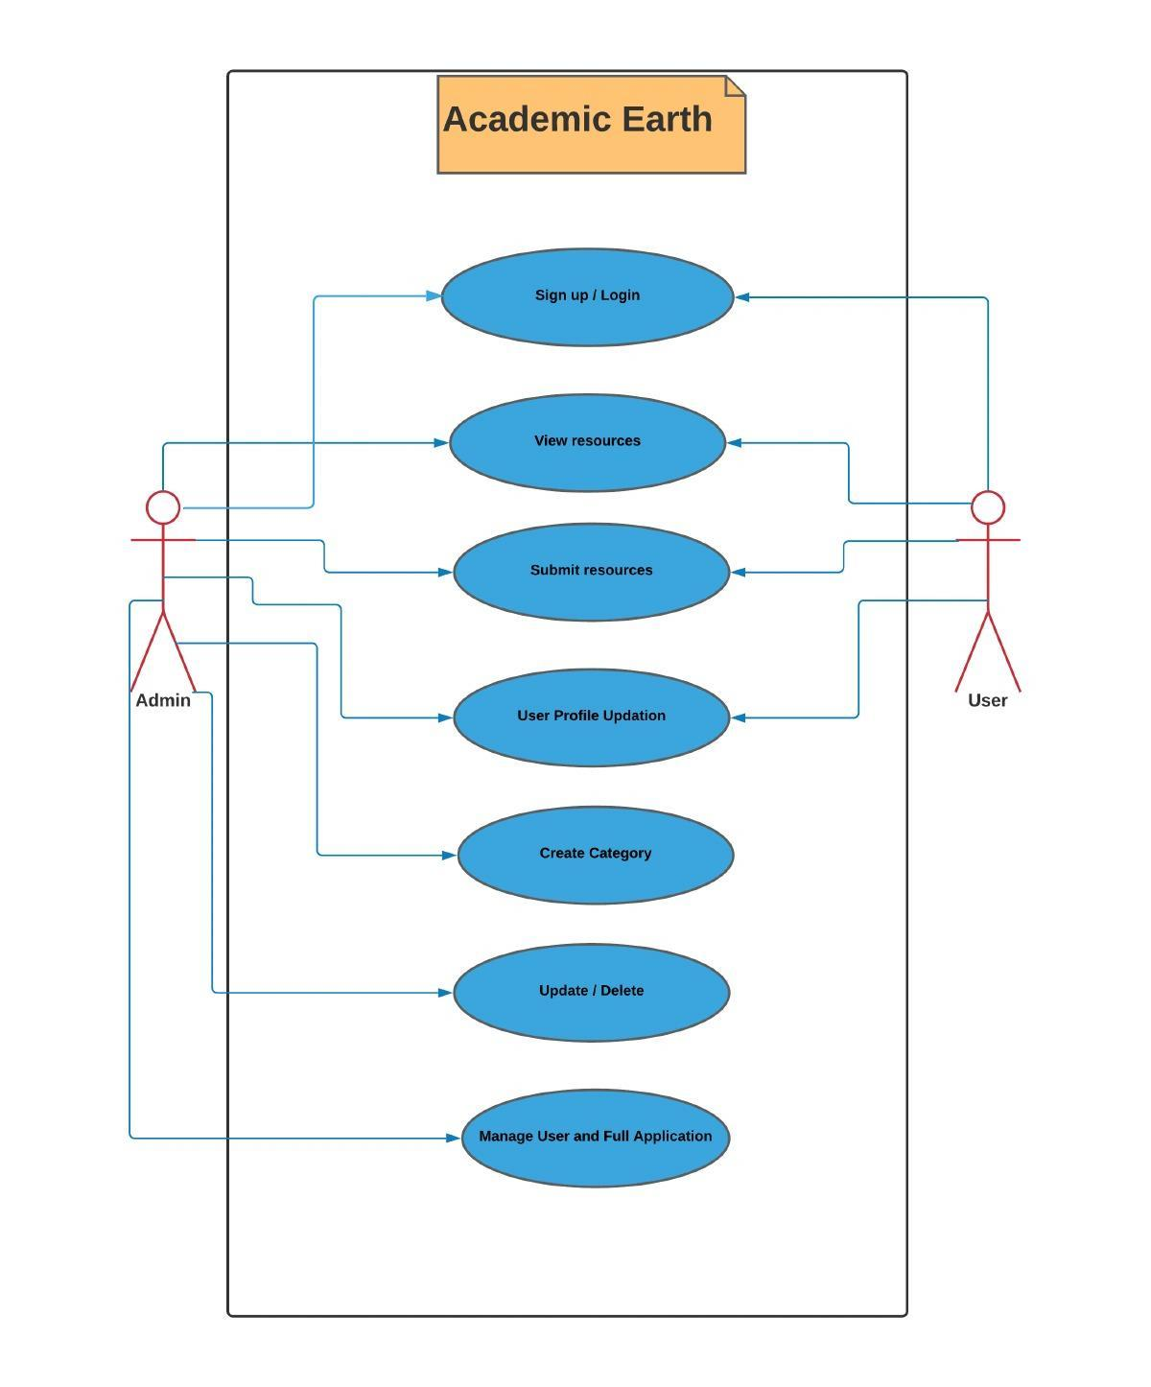
Use Case:
Modules:
Sign Up / Login
View Resources
Submit Resources
User Profile Update
Create Course Category
Update / Delete
Manage user Access

Slide 24
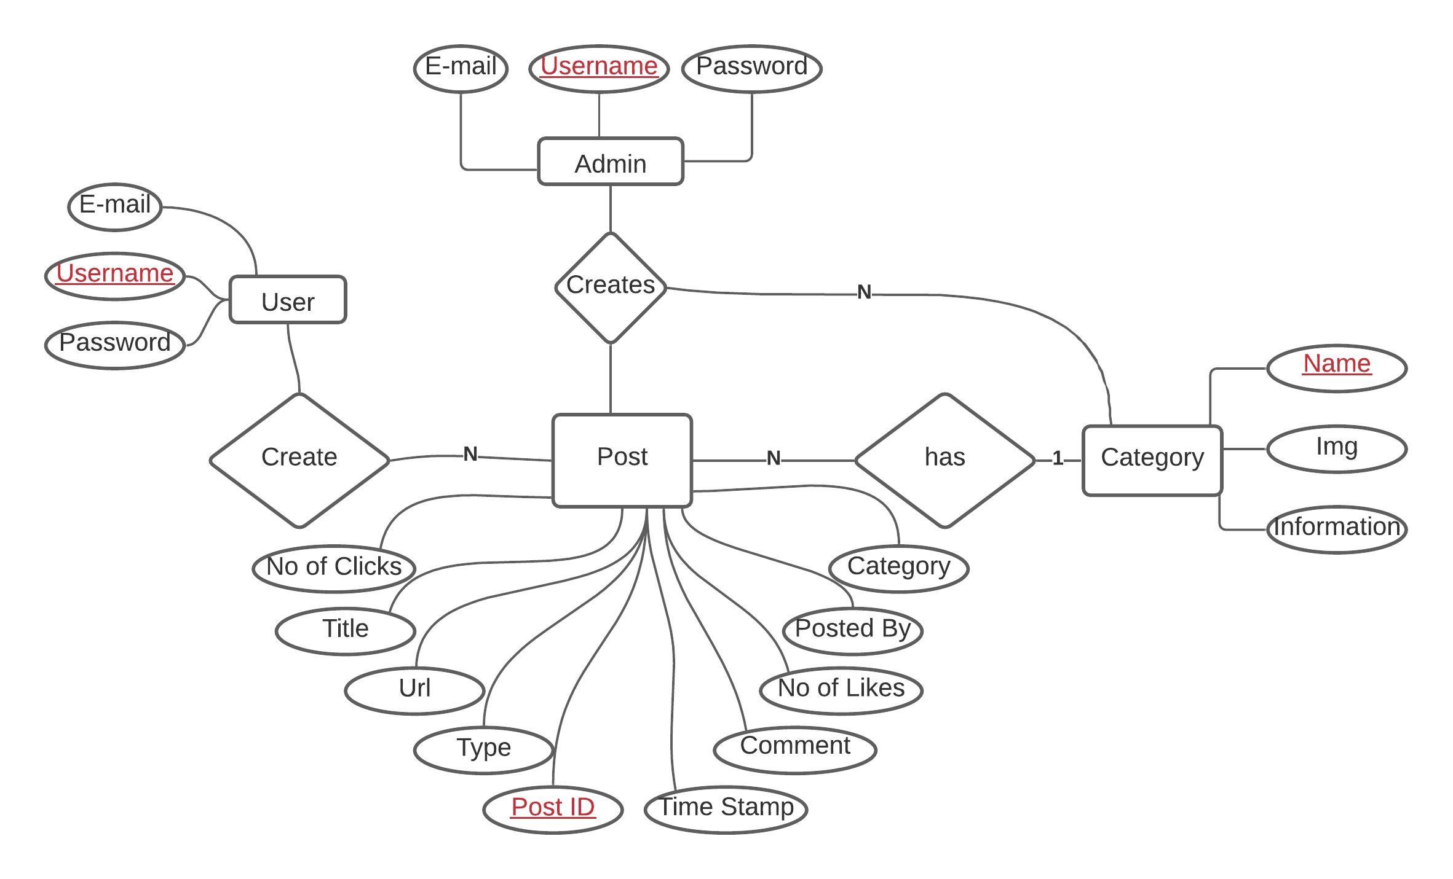
ER Diagram:

Slide 25
Thank You
-Team Academic Earth
Notes:
In Slide Show mode, click the arrow to enter the PowerPoint Getting Started Center.

